Slide 1
GotCha !
AR PROJECT
Immersive Media Programming
TEAM 4
Kim HwiNyeon
Lee JeaMin
Song JeaHan
Jo HyeongChan

Slide 2
Content
1
Introduction
2
Trailer
3
Architecture
4
Work Division

Slide 3





1
Introduction
What is ‘GotCha!’
Spray
Game you must catch mosqutios around you in time.

Slide 4
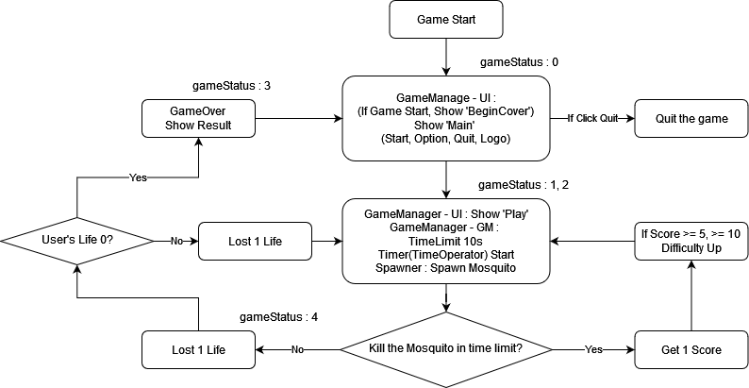
1
Introduction
Game Flow

Slide 5
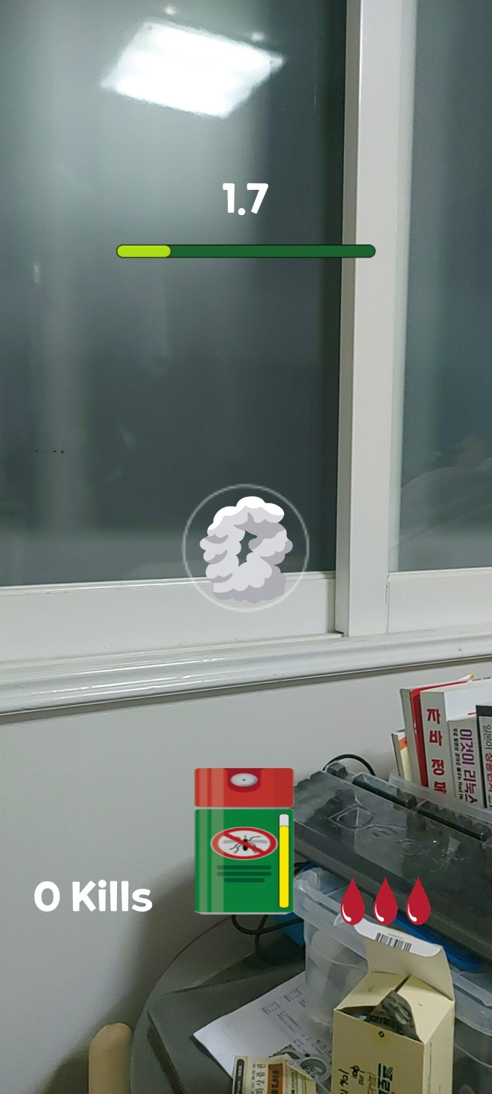
1
Introduction
Game Flow
Play Example

Slide 6


1
Introduction
Implemented Features
Player
Mosquito
UI / GM
Spawner
+ a

Slide 7
1
Introduction
Implemented Features
RayCast (Using Gauge), HP
Player
Move / Attack
Mosquito

Slide 8
1
Introduction
Implemented Features
Mange the Overall Flow of game
UI / GM
Spawn / Destroy /Manage Mosquitos
Spawner

Slide 9



1
Introduction
Implemented Features
First Aid
Music Controller

Slide 10
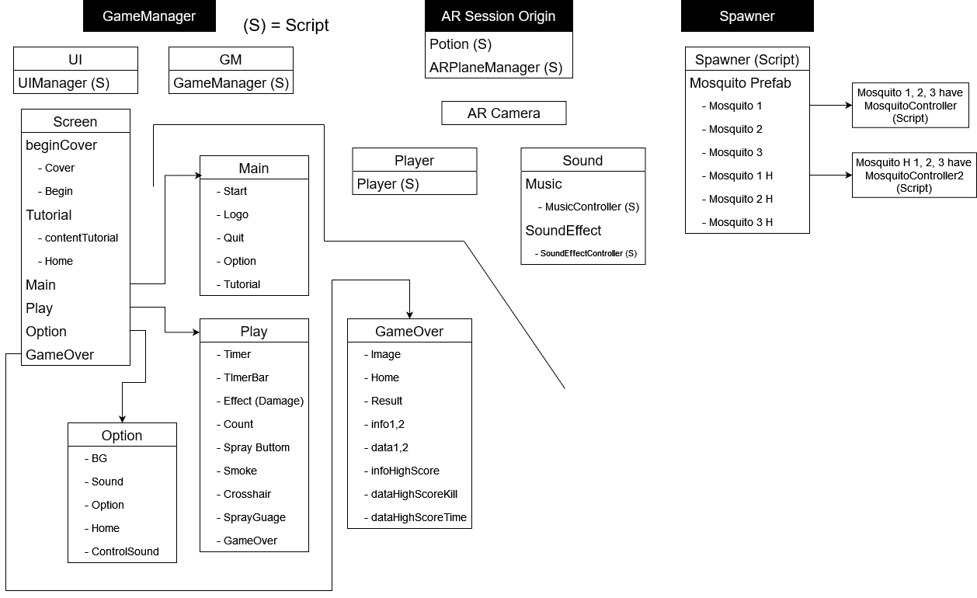
1
Introduction
Implemented Features

Slide 11
2
Trailer
Game Play

Slide 12
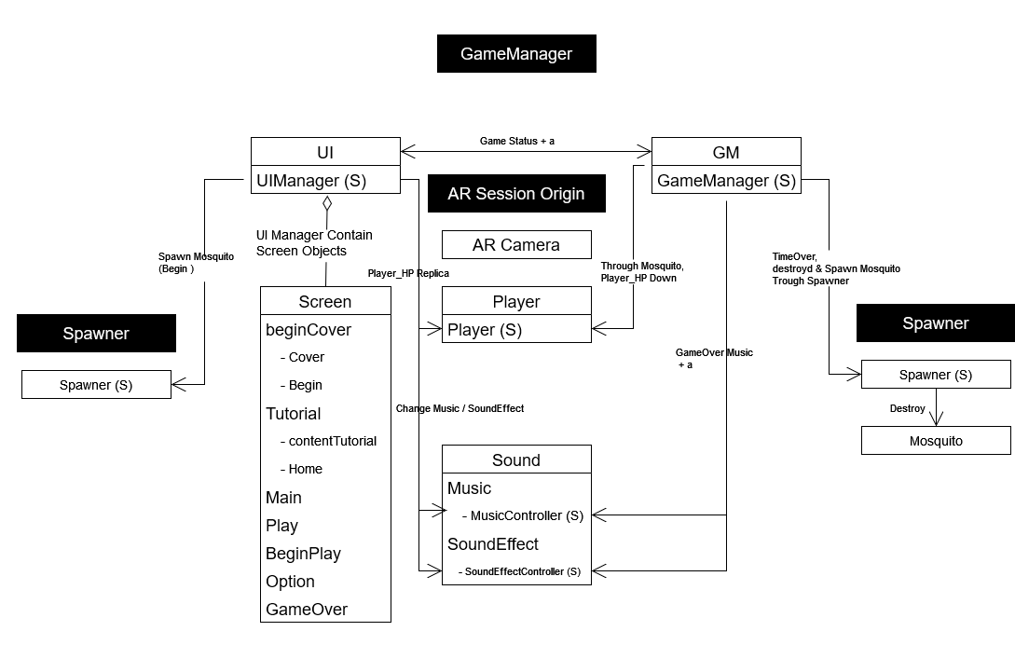
3
Architecture
Class Diagram

Slide 13
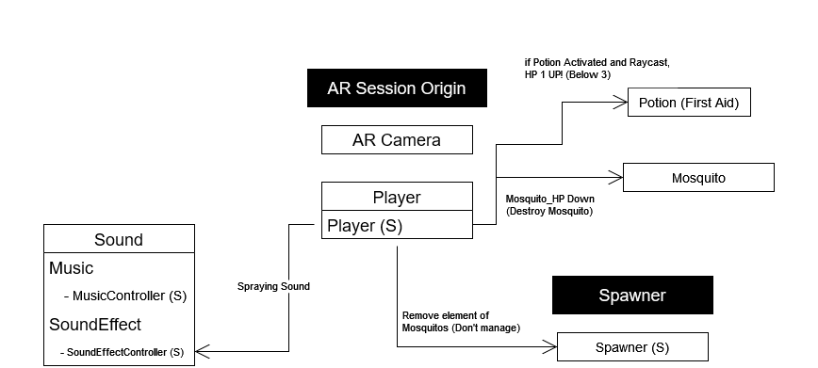
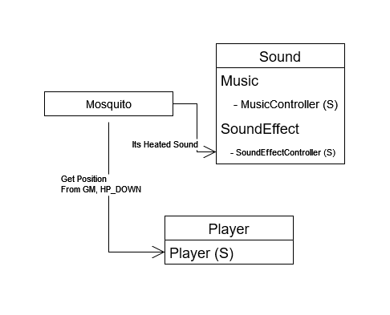
3
Architecture
Class Diagram

Slide 14
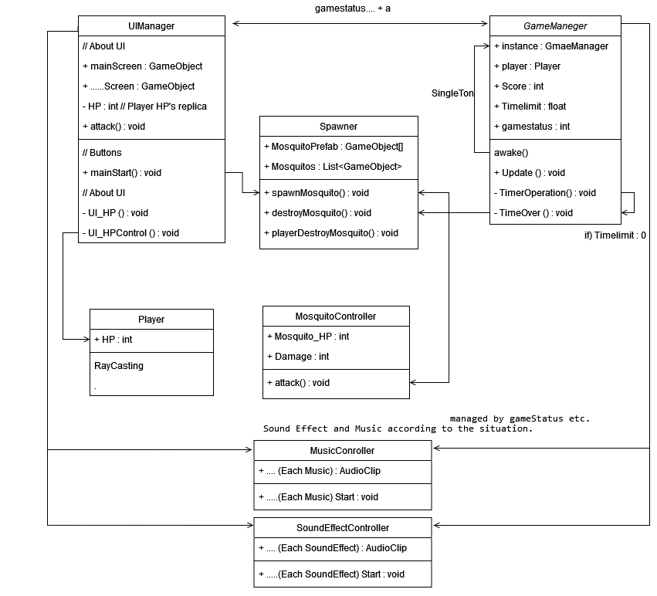
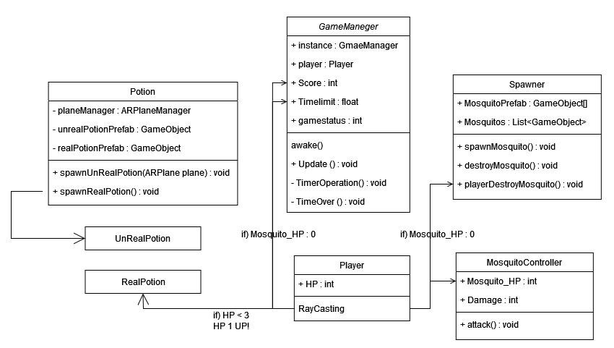
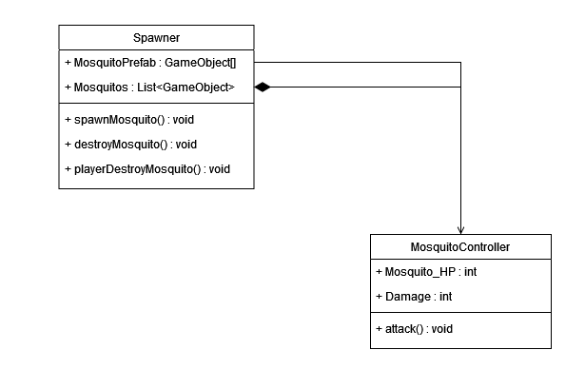
3
Architecture
Class Diagram

Slide 15
3
Architecture
Class Diagram

Slide 16
3
Architecture
Class Diagram

Slide 17
4
Work Division
Kim HwiNyeon
Mosquito, Sound Script & Documents Creating, Initial integration
(Level Design, Detailed class diagram, integrated, parts of animation, sound, spawner. created documents)
Lee JeaMin
Game Design, Player Script & Visual update
(Implementing the game foundation (like GM’s Singleton pattern.), Initial flow charts, On AR touch, Spraying)
Song JeaHan
UI Design, Game Manager Script & Sound, Visual Update
(Implementing almost of UI. Part of sound update, manage game flow, Design almost of our game visual)
Jo HyeongChan
Spawner, Potion Script & Visual update
(Implementing Potion Script, Parts of Spawner. Potion visual update, document)

Slide 18
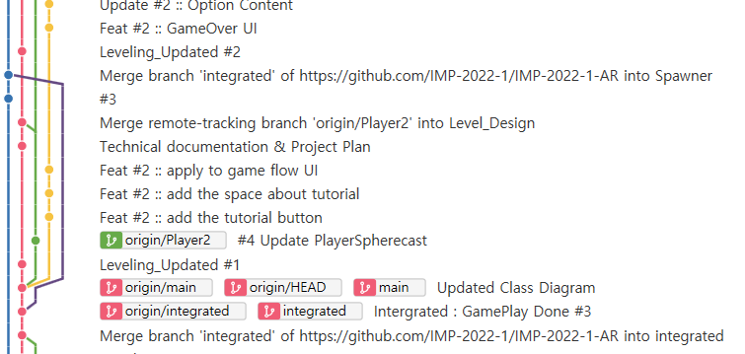
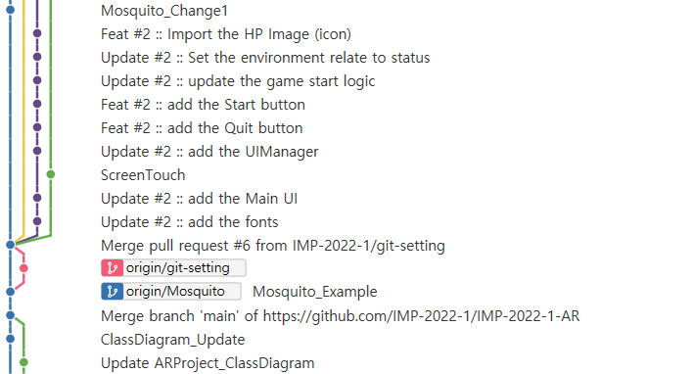
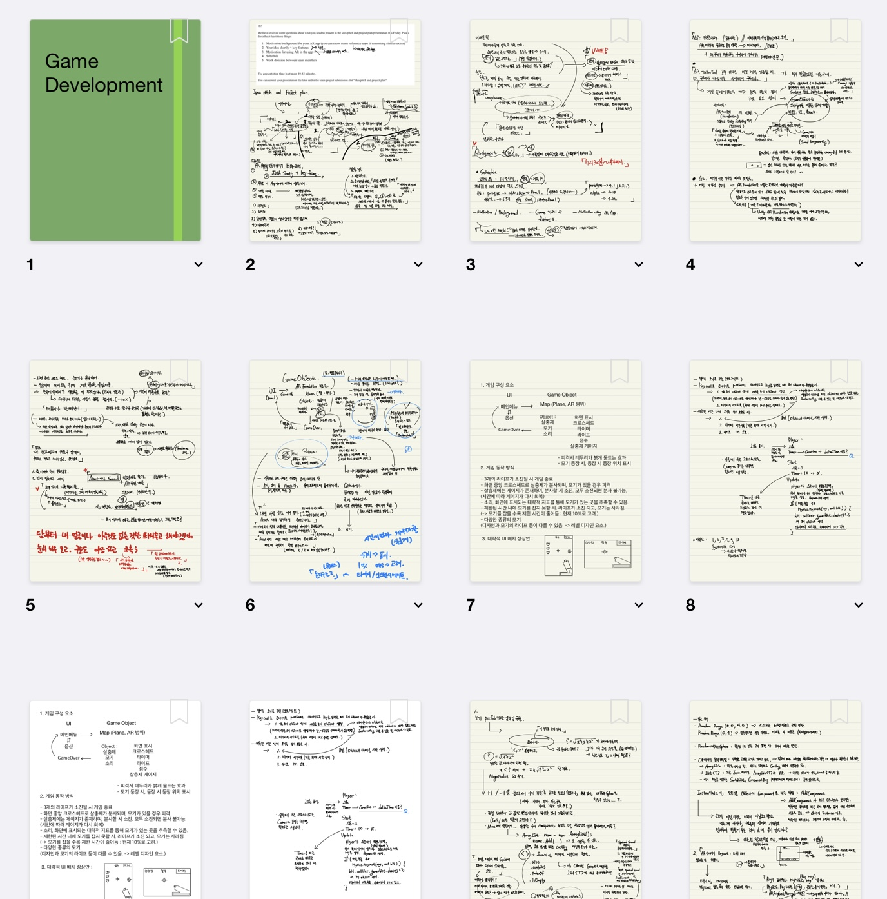
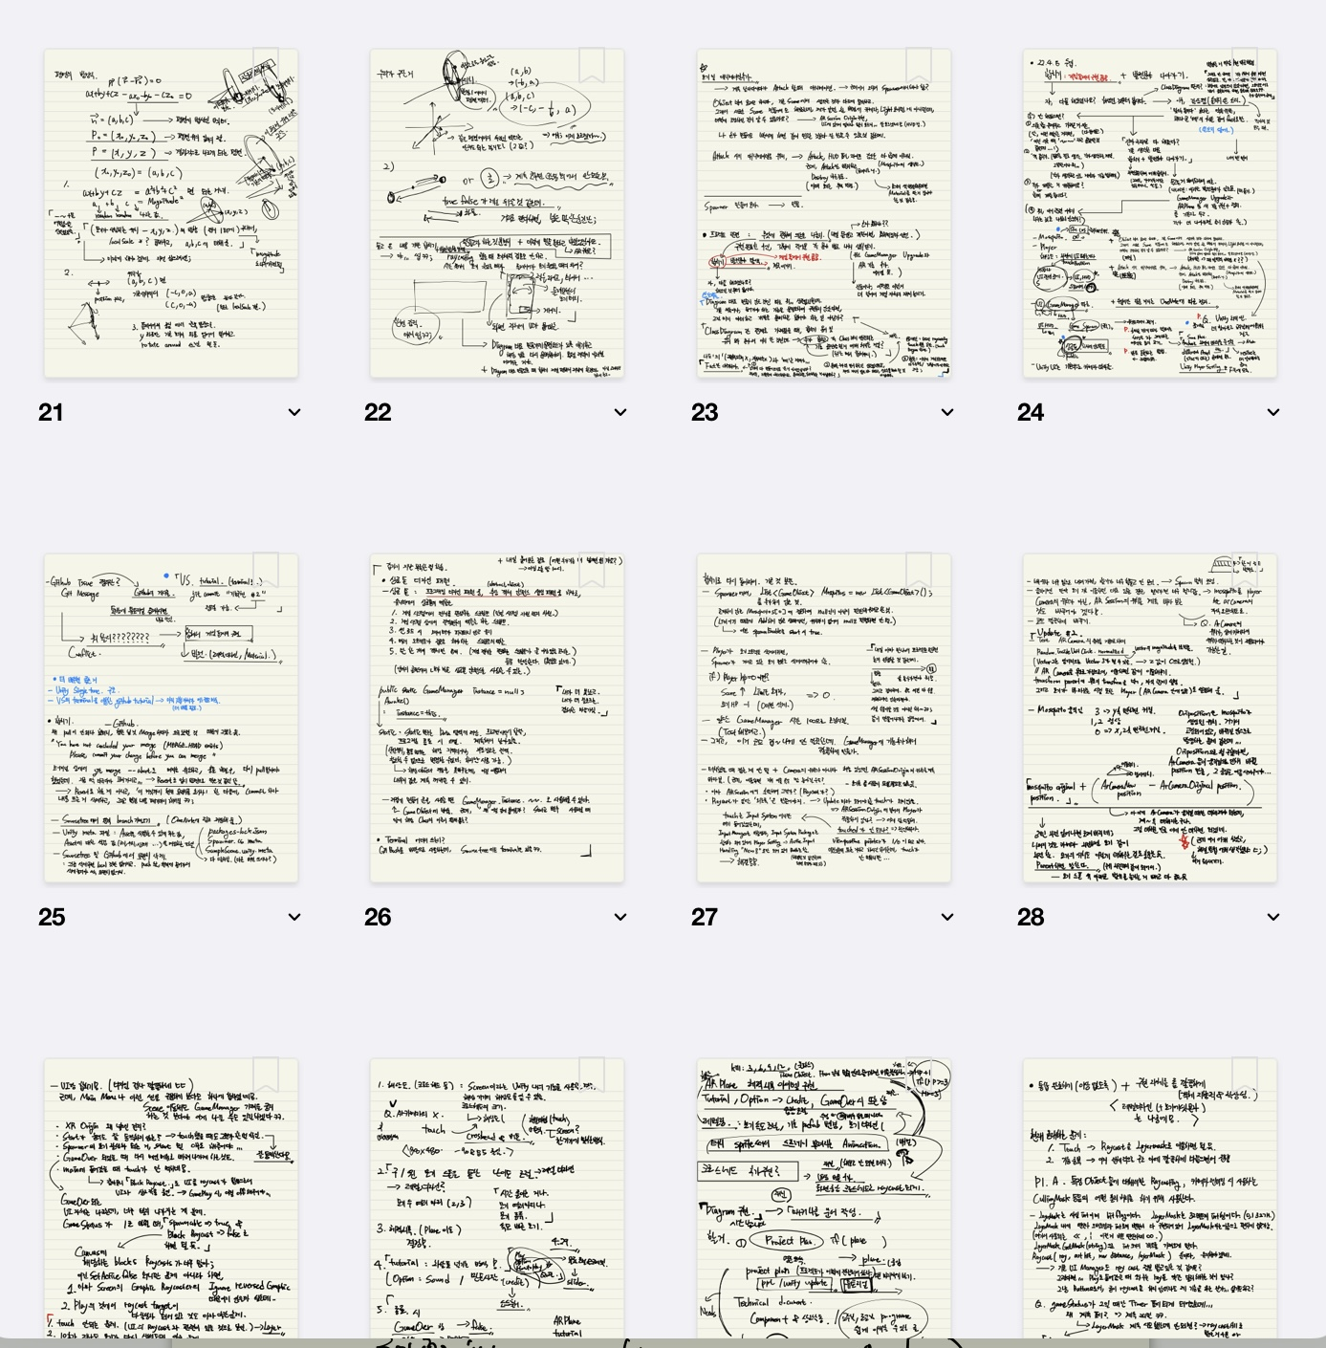
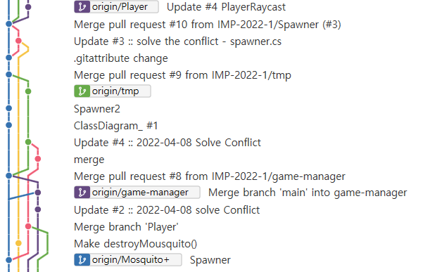
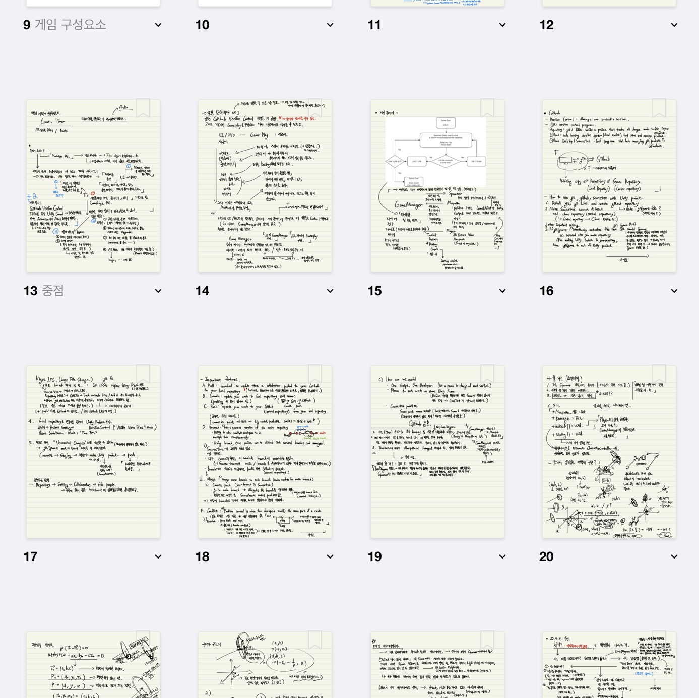
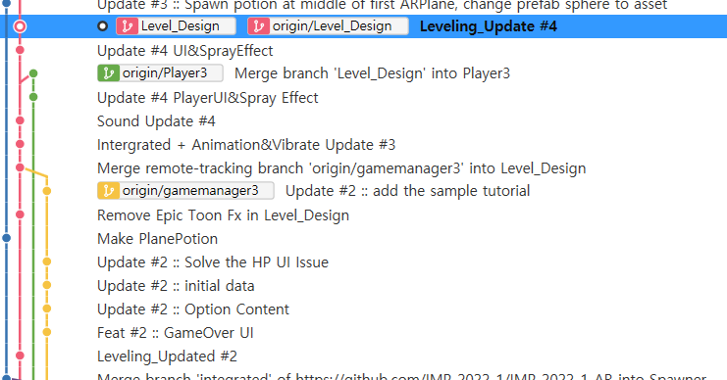
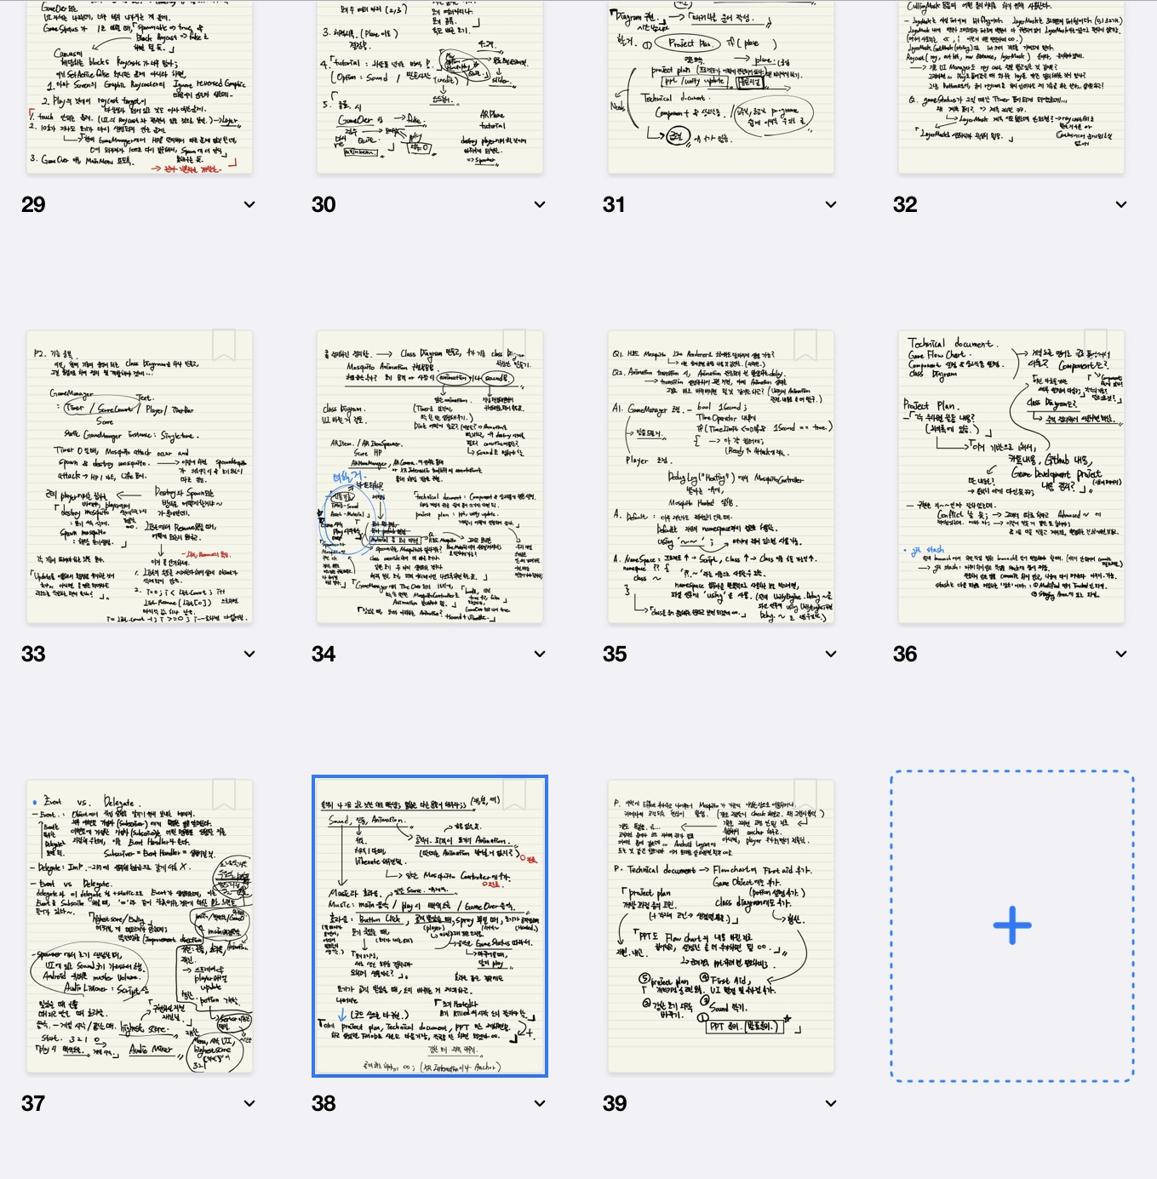
-
Have done
(Content)

Slide 19
-
PPT Resource References
Where are that resource from
<a href="https://www.flaticon.com/free-icons/spray" title="spray icons">Spray icons created by Freepik - Flaticon</a>
<a href="https://www.flaticon.com/free-icons/user" title="user icons">User icons created by Freepik - Flaticon</a>
<a href="https://www.flaticon.com/free-icons/music" title="music icons">Music icons created by Freepik - Flaticon</a>
<a href="https://www.flaticon.com/free-icons/hatchery" title="hatchery icons">Hatchery icons created by Freepik - Flaticon</a>
<a href="https://www.flaticon.com/free-icons/first-aid-kit" title="first aid kit icons">First aid kit icons created by Triangle Squad - Flaticon</a>

